Slide 1
Important Concepts

Slide 2
Contents
CNN - Introduction

Slide 3
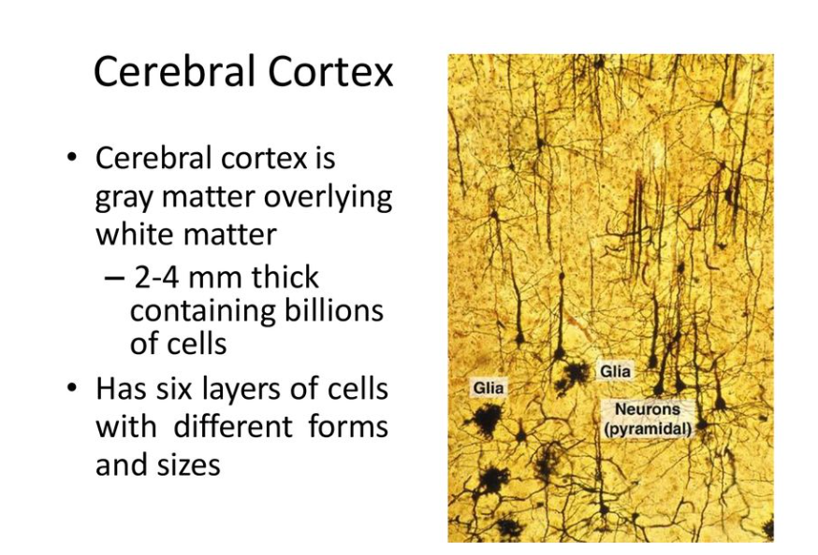
CNN - Intuition

Slide 4
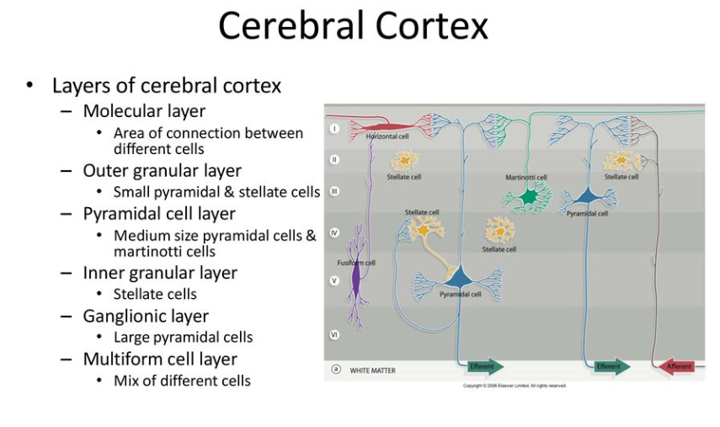
CNN - Intuition

Slide 5
What is Convolution?
Images: Gray Scale(black and white) or colored images
v

Slide 6
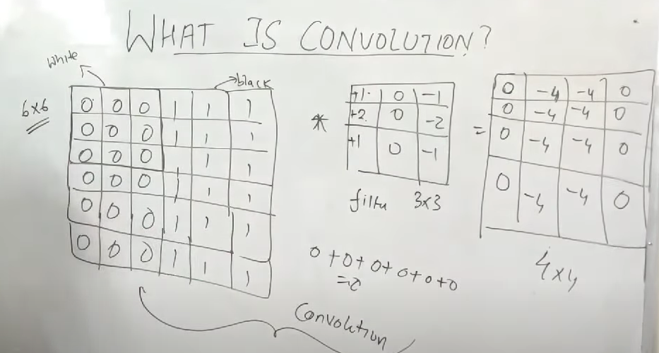
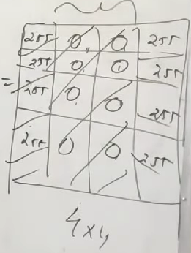

Slide 7
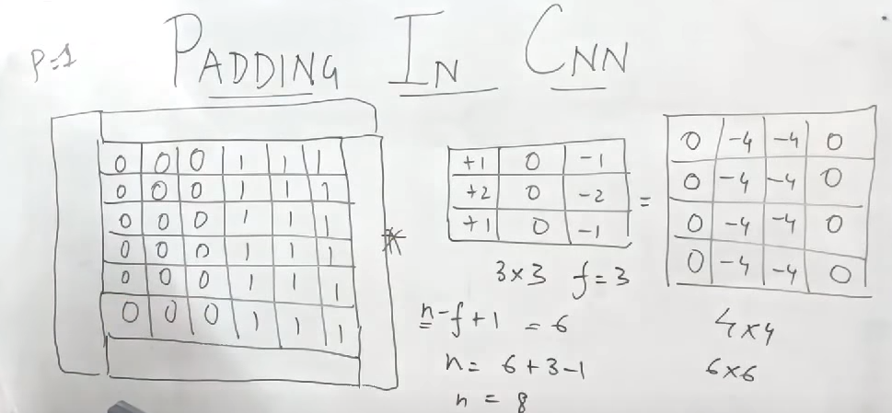
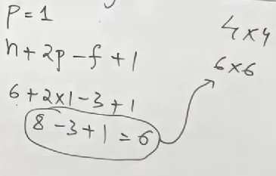
Padding in CNN
ZERO PADDING

Slide 8
